Slide 1
Tracking for Credentialed Ministry
Do your best to present yourself to God as one approved, a worker who does not need to be ashamed and who correctly handles the word of truth.
2 Timothy 2:15

Slide 2
Credentialed Ministry in the FMCiC
The process toward credentialed ministry is a journey, marked by significant moments and events along the way. This presentation provides an overview of this process which we call ‘tracking’. This resource should be used along with Chapter 8, paragraphs 805-840 from the Manual of the FMCiC.
https://www.fmcic.ca/our-ethos/the-manual/
Let the journey begin….

Slide 3
Credentialed Ministry in the FMCiC
Both gifts and graces characterize men and women the church ordains and commissions. Gifts are special endowments of ability. Graces are special qualities of character. Both have their source in the enabling Holy Spirit. Although the church must discern who have such endowments, credentialed ministry is always first and foremost an act of God’s calling and appointment.

Slide 4
Credentialed Ministry in the FMCiC
Credentialed ministry is both a calling and a profession. It is a calling in that it is a response to a divine summons. It is a profession in that this service is worked out under the direction of the church that sets ministers apart as leaders and requires accountability.
(from Chapter 8, par. 800 in the Manual of the FMCiC https://www.fmcic.ca/our-ethos/the-manual/)

Slide 5
Call to Credentialed Ministry
If you sense a call from God for pastoral leadership:
You already know the internal dialogue and journey you are experiencing with God.
We also look to other leaders in the local church to discern and confirm that you possess the gifts and graces for credentialed leadership.
Finally, we look to the Ministerial Education Guidance and Placement committee (affectionately referred to as MEGaP) to affirm and recommend you for either ordained or commissioned ministry.

Slide 6
This confirmation of call is like a three-legged stool; all legs need to be about the same length for the stool to be effective and likewise all three aspects of call need to be present for credentialed ministry.

Slide 7
Called to ORDINATION
If you are called to pastoral oversight of a local congregation – that is, ministry of Word and Sacrament and Leadership – and are willing to move to minister at different congregations, then tracking for ordained ministry is the way to prepare for that call.

Slide 8
Called to ORDINATION
The local church first issues a Lay Minister’s License.
The Lay Minister (LM) is contacted by the Credentialing Coordinator, begins tracking by taking some courses, submitting documents and doing some assignments.
Then the LM has the first interview with MEGaP to be recommended as a Ministerial Candidate (MC).

Slide 9
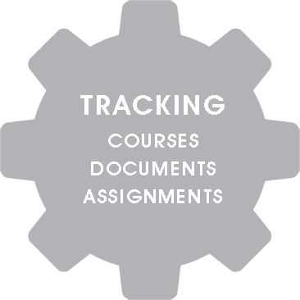

Slide 10
Called to ORDINATION
After becoming a Ministerial Candidate (MC), four years of ministry experience under appointment at a local church plus additional courses are required.
During the 4 years, there are at least two MEGaP interviews. Following the final interview and subsequent recommendation by the MEGaP for the MC to be ordained, the recommendation goes to the National Board of Administration (BoA) for final approval.
Once approved, the Bishop of the FMCiC will ordain the Ministerial Candidate at the local church at a time that is mutually agreed upon.

Slide 11
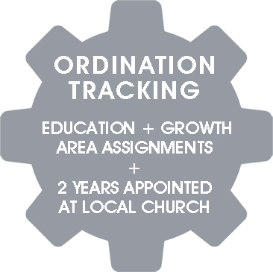

Slide 12
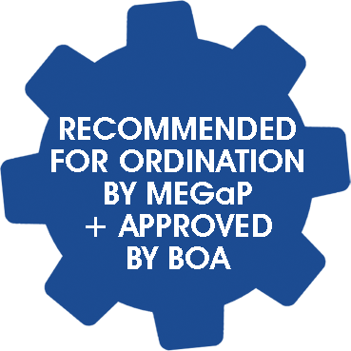
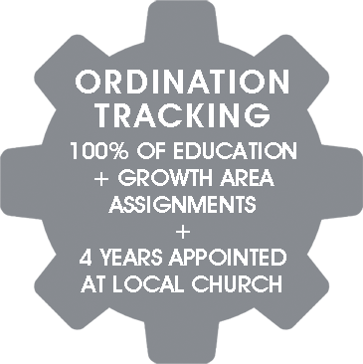

Slide 13
Called to COMMISSIONED MINISTER
If you are called to a specialized ministry at one local church, then tracking for commissioned ministry is the way to prepare for that call.

Slide 15
Called to COMMISSIONED MINISTER
The local church first issues a Lay Minister’s License.
The Lay Minister is contacted by the Credentialing Coordinator, begins tracking by taking some courses, submitting documents and doing some assignments.
Then the LM has the first interview with MEGaP to be recommended as a Ministerial Candidate (MC).

Slide 16
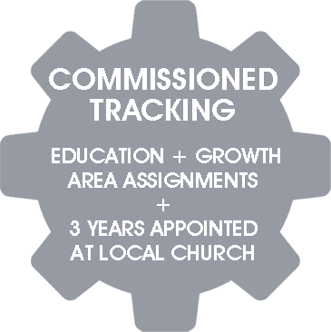

Slide 17
Called to COMMISSIONED MINISTER
There is at least one MEGaP interview beyond the MC interview to become a Commissioned Minister.
Following the final interview and subsequent recommendation by the MEGaP, the recommendation goes to the National Board of Administration (BoA) for final approval.
Once approved, the Bishop or his designate from the FMCiC will commission the MC at the local church at a time that is mutually agreed upon.

Slide 18
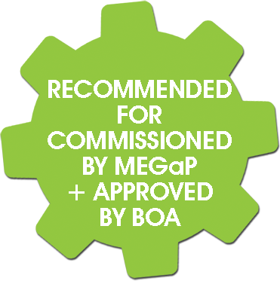

Slide 19
Ordination or Commissioning Service
When you are notified that the BoA has approved the recommendation from MEGaP for ordination or commissioning, contact the Bishop’s office to schedule the service.
A Commissioning generally occurs during a worship service while Ordinations are held at a time separate from a worship service

Slide 20
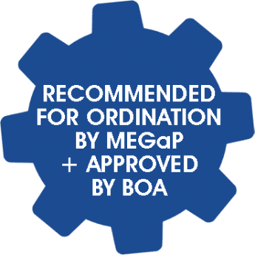
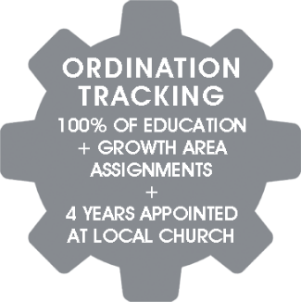
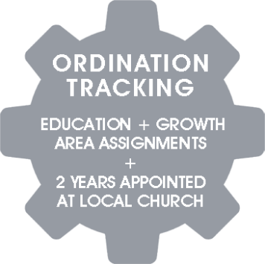
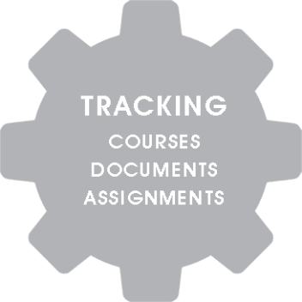
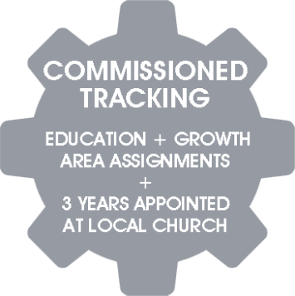
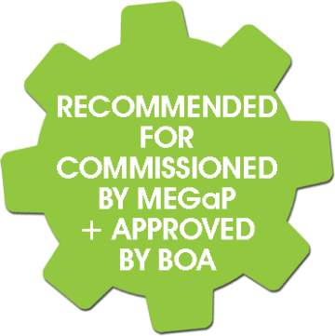
Tracking for Credentialed Ministry in The FMCiC

Slide 21
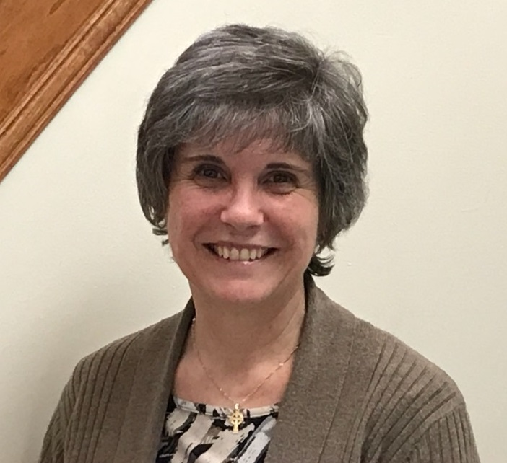
Credentialing Coordinator
Once a Lay Minister’s license has been issued from the local church, you will be contacted by:
Susan DePlanché-Credentialing Coordinator
Leadership Development Office
The Free Methodist Church in Canada
289-228-1225 (cell)
susan.deplanche@fmcic.ca

