Slide 1
Regional Gatherings 2015

Slide 2
What is the Holy Spirit saying to local church leaders about
“Next Steps” together?

Slide 8
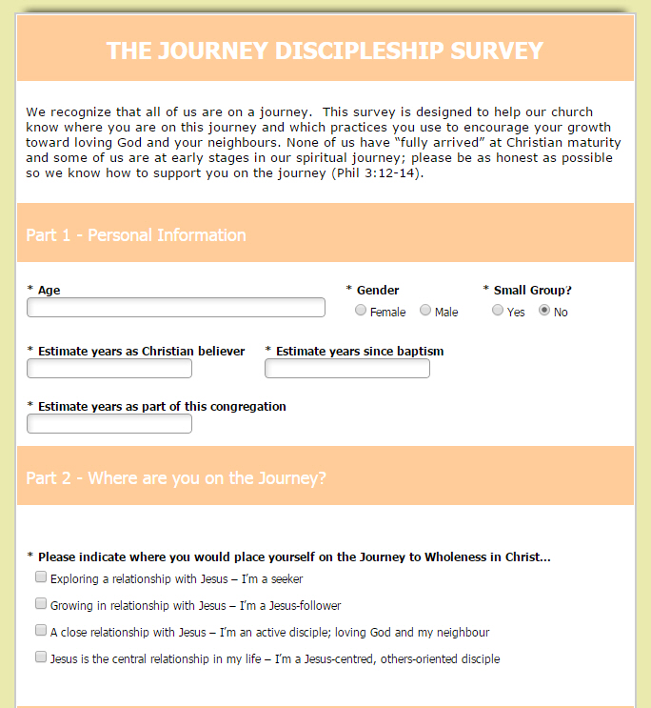

Slide 10
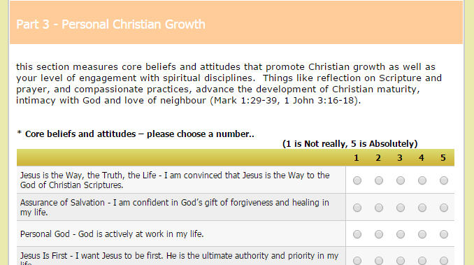

Slide 11
The Wesleyan Way
Making Disciples for Missional Living

Slide 13
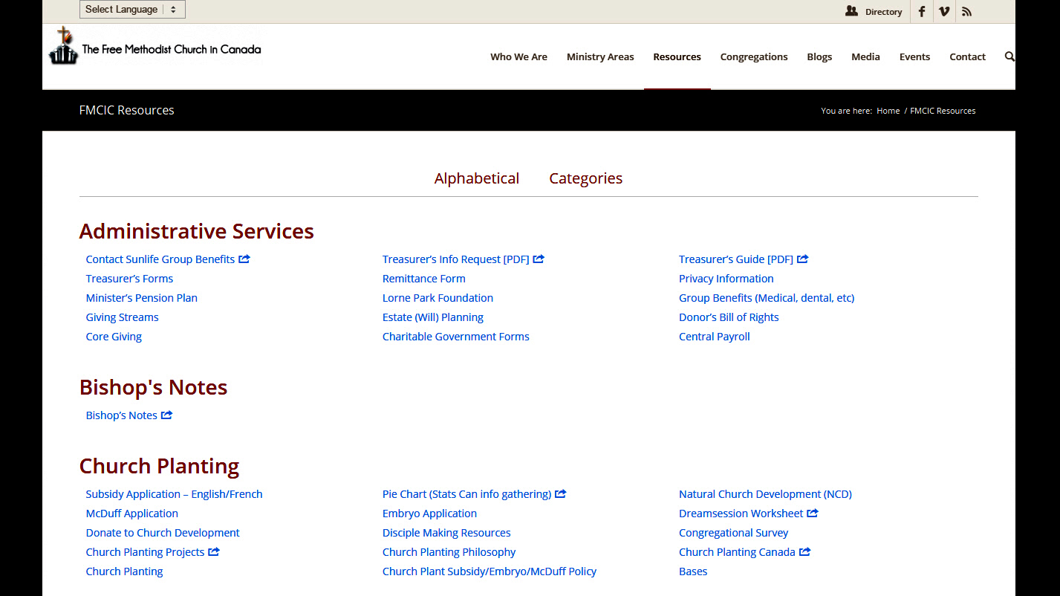

Slide 14
A Wonderful Story of God’s Provision
2014 budget (a deficit!!) -$221,985
December 31, 2014 Balance $56,200
How did that happen???
Core Giving
2014 Core budget $1,228,240
2014 Core receipts $1,257,332
Underspending
NLT in home offices – office rental income
Investment income

